Slide 1




























-— 8th Annual —
HOSTED BY

Slide 2


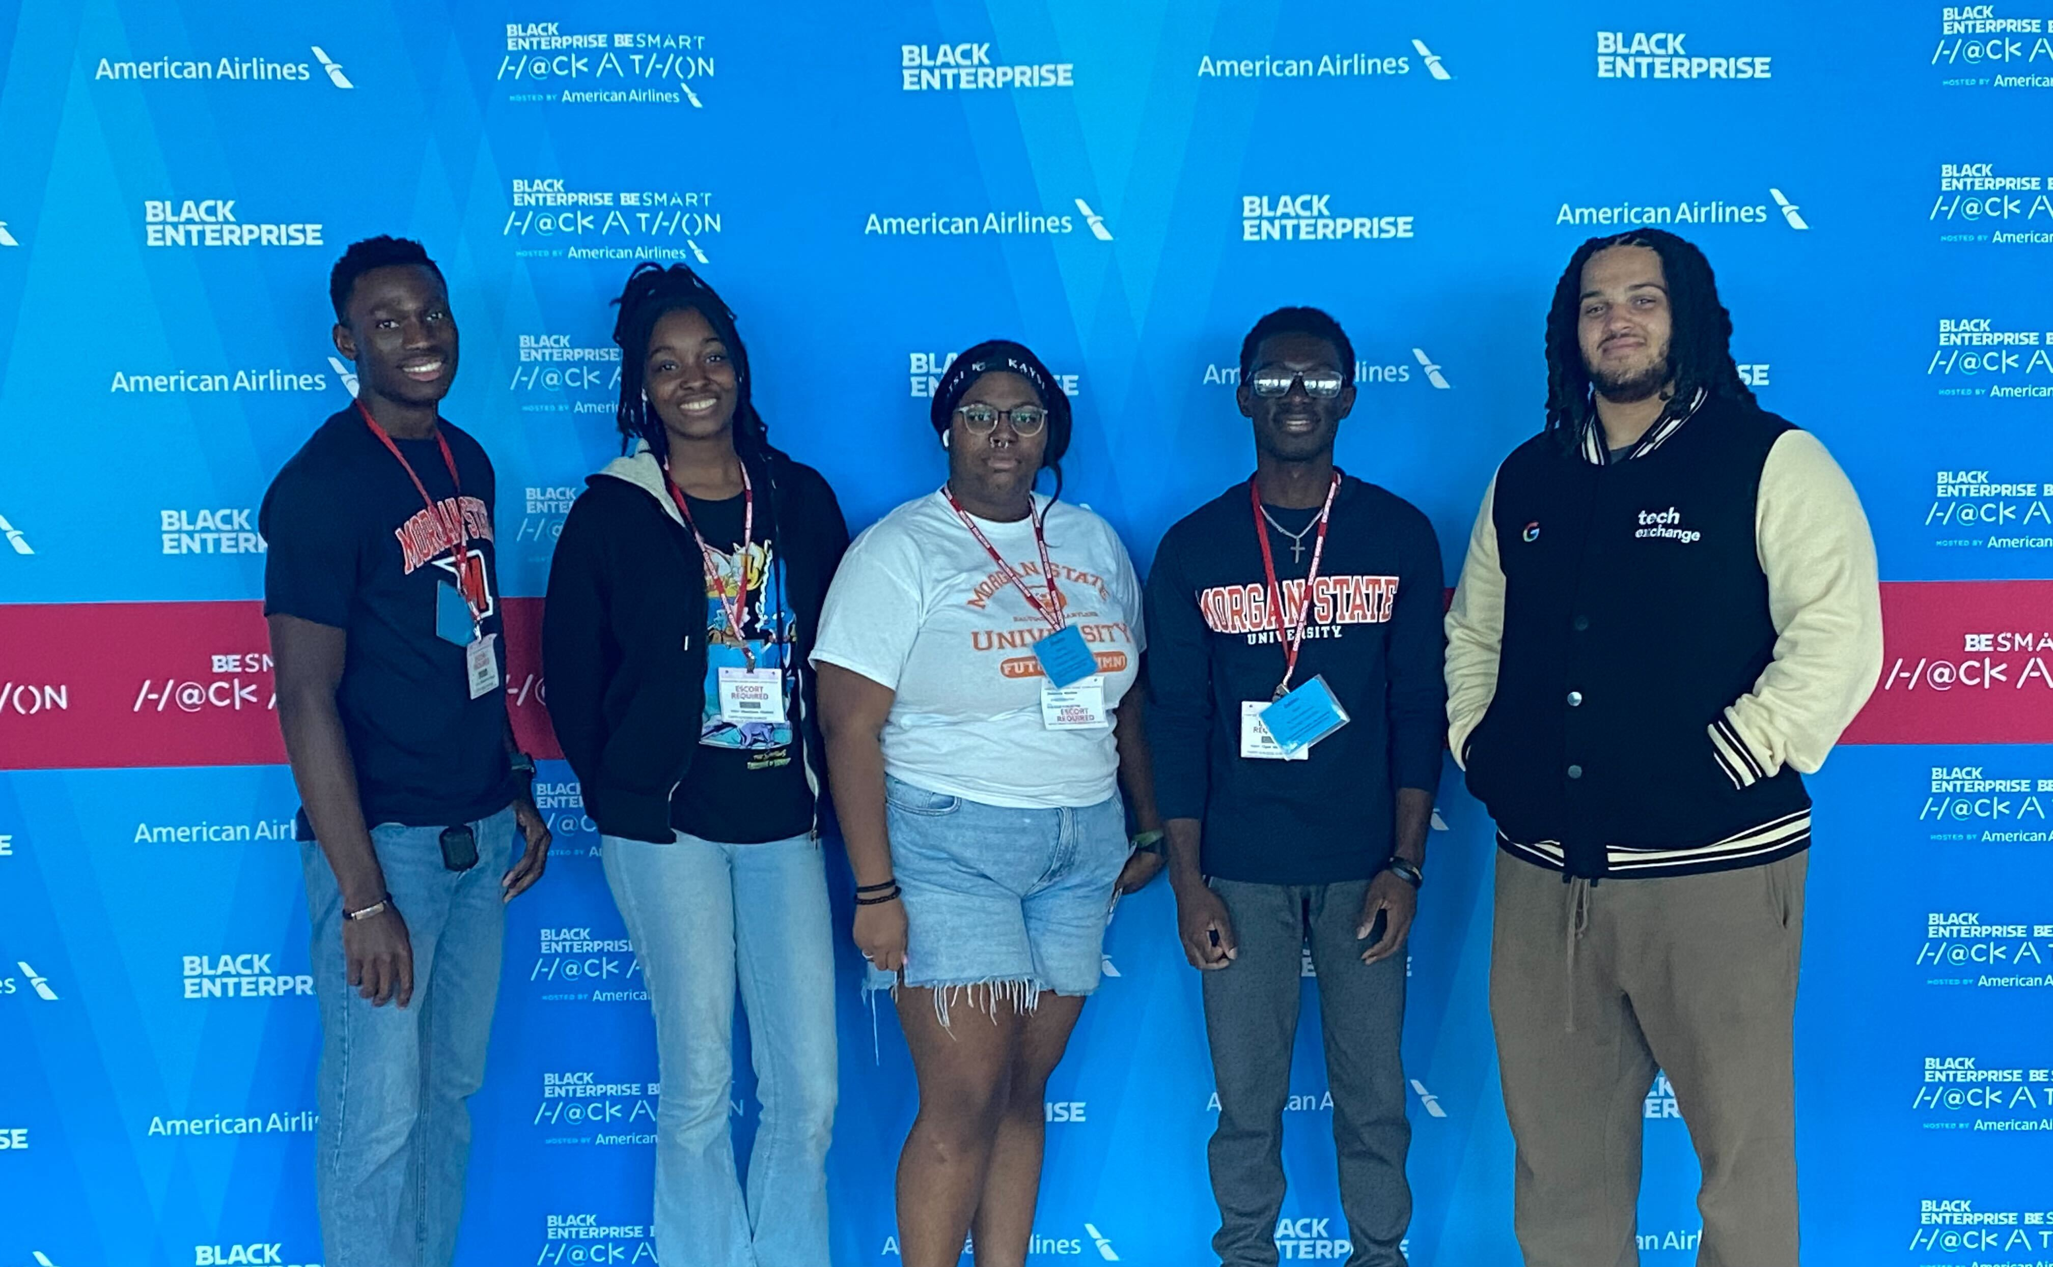
Code Bears
Flight Pro
Web app that predicts possible flight delays as well as allows the user the benefit of viewing what they can do for when their flight is delayed.
TEAM MEMBERS
Shaimeira Meekins
Ebunoluwa Oludemi
Clyde Baidoo
Lerone Joyner
Oluwanifemi Mebude

